Slide 1
ITSC 306: Computer Forensics
Module 4, Week 6: Capturing Data Over the Network

Slide 2
Module Textbook Readings
Chapter 6

Slide 3
Module Objectives
Discuss the techniques of capturing data over a network.

Slide 4
Introduction
Capturing data over the network is an uncommon procedure. Most acquisitions are completed on-site or in a lab environment with seized media.
Capturing data over the network may be feasible when:
The suspect computer is in a remote location
A covert vs. overt capture is required
The computer can’t be removed or physically opened to access the hard drive
It is easier in a business environment to deploy an enterprise solution
Involves deploying a secure network connection between the suspect and target computer

Slide 5
Challenges
Collecting evidence over the network produces challenges not encountered with traditional physical captures:
How do you authenticate the evidence? It’s live.
Someone is still required to interact with the suspect system at the scene to allow the connection between the suspect and target system.
Notes:
Authenticating is more difficult when you don’t have physical access to the media. Second, remember that if the evidence is being collected over the network, the system is live. Traditional hashing won’t work.

Slide 6
Network Basics
“Ncat is a general-purpose command-line tool for reading, writing, redirecting, and encrypting data across a network. […] Ncat is suitable for interactive use or as a network-connected back end for other tools.”
(Ncat Users' Guide)

Slide 7
Ncat
Ncat has the ability to read and write data across the network.
Ncat can be used in the following situations:
- As a client to interact with servers and other clients
- Acts as a server to offer services to clients
- Is multi-platform: Windows, Linux, OSX
- Supports encryption

Slide 8
Installing Nmap
Ncat is part of the Nmap program. Ncat will be used in the following examples during this lecture.
On your SIFT workstation, run the command:
sudo apt-get install nmap
On Windows, download and install the file nmap-7.40-setup.exe from https://nmap.org/download.html#windows
Notes:
Download the install ncat on both Windows and Linux to complete these exercises.

Slide 9
Example 1 — Making the Connection
In this example, you will make a network connection between your Windows and SIFT systems.
In Windows, open a Command Prompt. In SIFT, open a Terminal.
Run ifconfig on Linux to confirm and document your IP.
Notes:
Check the Network preferences on the SIFT VM to ensure both OSs are on the same subnet.

Slide 10
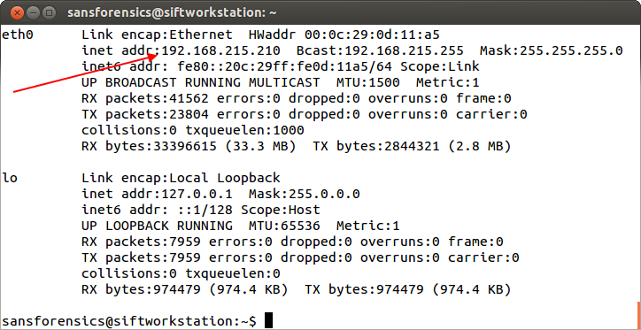
Step 1 — Making the Connection
In this example, the SIFT IP is 192.168.215.210.
In this example, the Windows IP is 192.168.215.207.
Source: SANS Institute. Reproduced and used in accordance with the fair dealing provisions in section 29 of the Canadian Copyright Act for the purposes of education, research or private study. Further distribution may infringe copyright

Slide 11
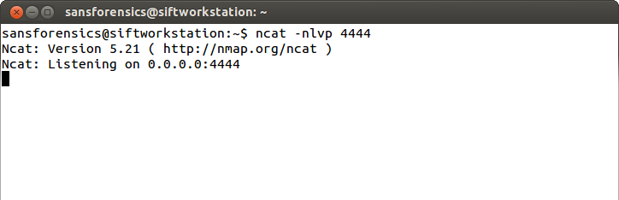
Step 2 — Making the Connection
In the SIFT system, set-up an Ncat listener by issuing the following command: ncat – nlvp 4444.
Once executed, Ncat reports that it is listening on port 4444.
Source: SANS Institute. Reproduced and used in accordance with the fair dealing provisions in section 29 of the Canadian Copyright Act for the purposes of education, research or private study. Further distribution may infringe copyright

Slide 12
Step 3 — Make the Connection
Connect to the Linux system through the Windows system by issuing the following command: ncat (IP of the Linux system) 4444
In this example: ncat 192.168.0.54 4444
The listening Ncat confirms that a connection has been established.

Slide 13
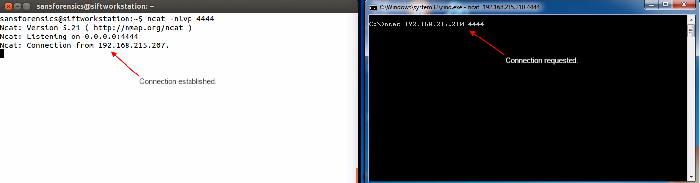
Step 3 — Make the Connection
Source: SANS Institute. Reproduced and used in accordance with the fair dealing provisions in section 29 of the Canadian Copyright Act for the purposes of education, research or private study. Further distribution may infringe copyright

Slide 14
Ncat Chat Session
Once the connection is established, you can chat between the two systems.
Type text into the command prompt and press ENTER.
The text is displayed in the SIFT Terminal.
To break the connection, press CTRL+C.

Slide 15
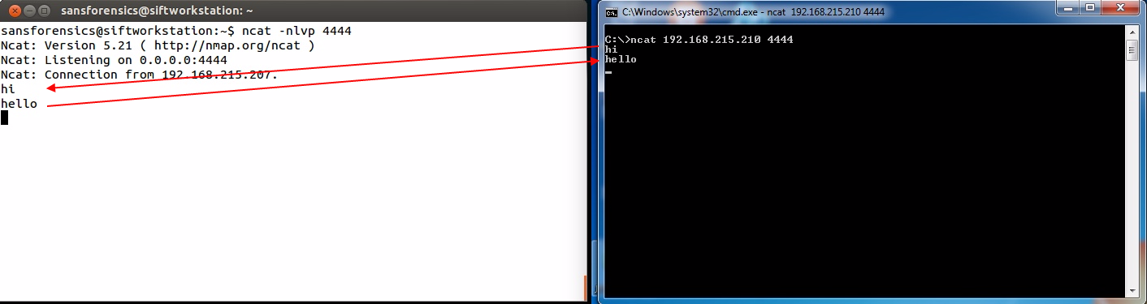
Source: SANS Institute. Reproduced and used in accordance with the fair dealing provisions in section 29 of the Canadian Copyright Act for the purposes of education, research or private study. Further distribution may infringe copyright

Slide 16
Summary
This simple example indicates that Ncat can be used as both a client and a server.
Ncat can be used to bound ports to make connections.
The command line syntax differs if Ncat is being used as a client or as a server.
The transfer of data within Ncat is encrypted.

Slide 17
Example 2 — Transferring Data
Now that you understand the basic functionality of Ncat, you can use it to transfer data between the two systems.
Similar to the Chat session, set up Ncat on the SIFT system to listen on Port 4444.
However, any incoming data will be directed to a file called ReceivingFile.txt.

Slide 18
Step 1 — Transferring Data
On the Windows system, create a text file called TestFile.txt.

Slide 19
Step 2 — Set-up a ncat Listener
On SIFT, start Ncat to listen on port 4444 and to direct any received data into a file called ReceivedFile.txt.
ncat —nlvp 4444 > ReceivedFile.txt
The connection closes after the transfer.

Slide 20
Step 3 — Set-up a ncat Listener
On the Windows system, start Ncat and connect to SIFT.
Send the TestFile.txt file.
ncat —nv 192.168.215.210 4444 < TestFile.txt

Slide 21
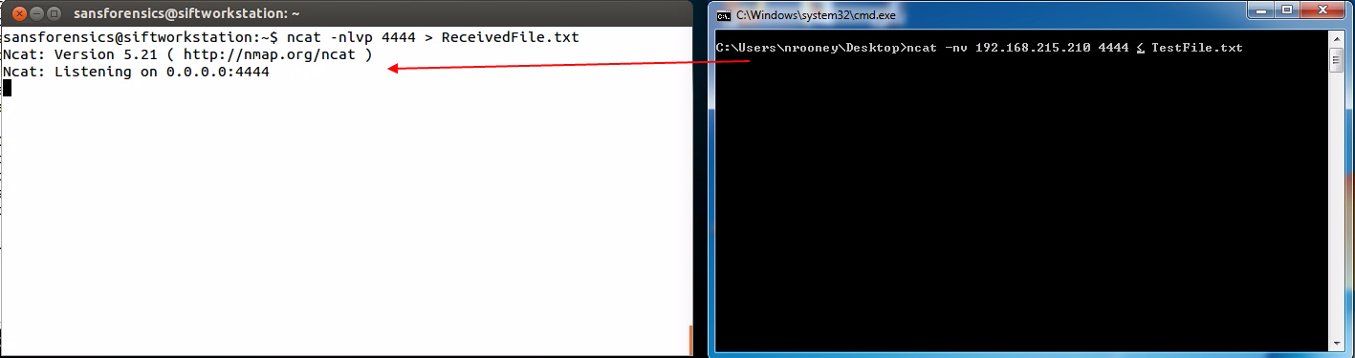
The Connection and Transfer
Source: SANS Institute. Reproduced and used in accordance with the fair dealing provisions in section 29 of the Canadian Copyright Act for the purposes of education, research or private study. Further distribution may infringe copyright

Slide 22
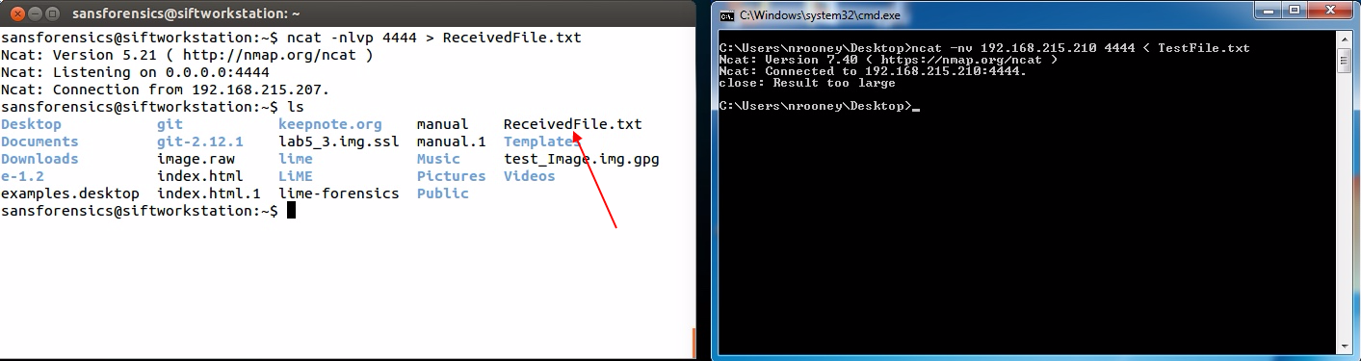
Step 4 - Confirmation
Run ls in SIFT to confirm the file has been received and created.
Source: SANS Institute. Reproduced and used in accordance with the fair dealing provisions in section 29 of the Canadian Copyright Act for the purposes of education, research or private study. Further distribution may infringe copyright

Slide 23
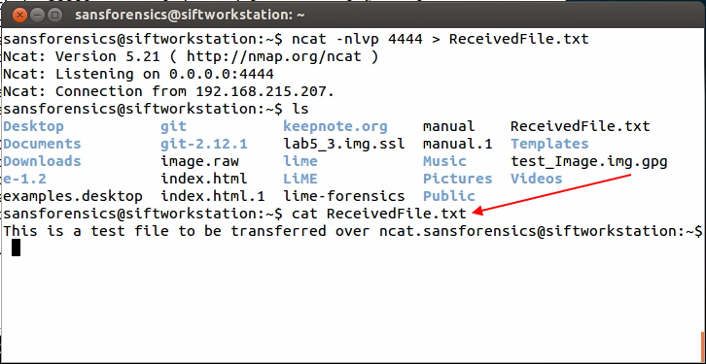
Run cat on the file ReceivedFile.txt to confirm its contents.
Source: SANS Institute. Reproduced and used in accordance with the fair dealing provisions in section 29 of the Canadian Copyright Act for the purposes of education, research or private study. Further distribution may infringe copyright

Slide 24
Example 3 — Remote Imaging using SSH
ssh is a Secure Shell used to establish a cryptographic connection between two systems.
ssh authenticates each system to the other and allows commands to be sent back and forth.

Slide 25
Example 3 — Remote Imaging using SSH
To use ssh, ensure it is installed and running on both the target and suspect systems.
On the suspect system, run dcfldd on an attached USB drive.
Pipe the output to ssh.
Use cat to direct the capture to an image file on your target system.
In this example, Linux is being used on both the suspect and target systems.
Notes:
Ensure ssh is started on the systems.

Slide 26
Running the Command using SSH
The command is:
dcfldd if=/dev/(device) bs=4k conv=noerror | ssh —l (Target Host Username) (IP of Target) “cat > (Image Name)”
dcfldd if=/dev/sdb bs=4k conv=noerror | ssh —l nrooney 192.168.70.136 “cat > image.raw”

Slide 27
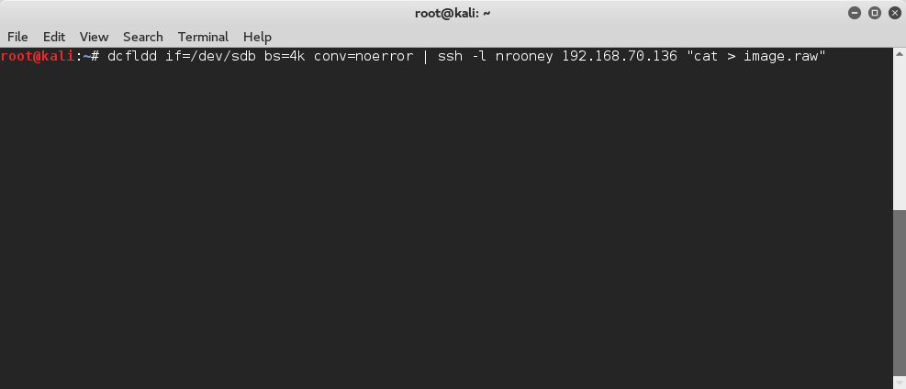
Running the Command using SSH

Slide 28
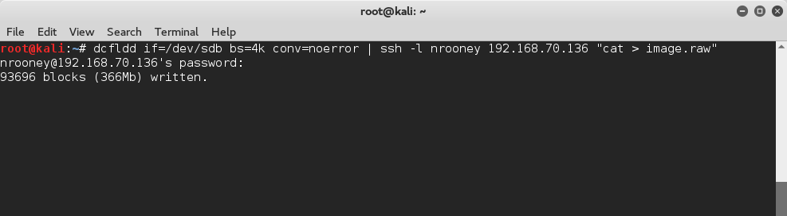
Before dcfldd begins, ssh requests the password for the user account being accessed on the target system.
Once it starts, a running status is displayed.

Slide 29
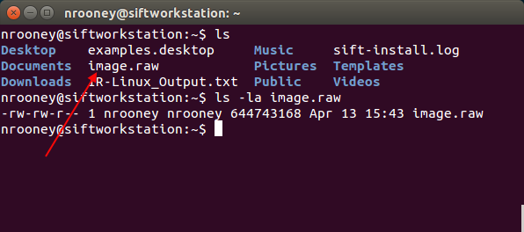
On the target system, the file is being written.
Source: SANS Institute. Reproduced and used in accordance with the fair dealing provisions in section 29 of the Canadian Copyright Act for the purposes of education, research or private study. Further distribution may infringe copyright

Slide 30
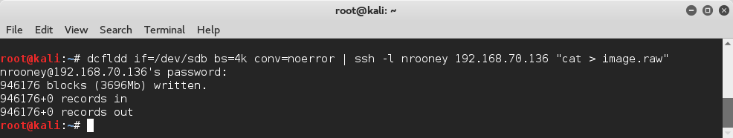
Once completed, the connection breaks.

Slide 31
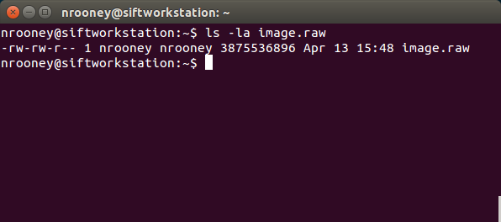
Running ls on the Target system confirms the transfer is successful.

Slide 32
Example 4 — Remote Imaging with rdd
rdd is similar to ssh and was developed by the Netherlands Forensic Institute.
Installed on SIFT, but can be added running the command sudo apt-get install rdd
Has built in options, such as compression, hashing, logging segmentation, progress and statistics
Unlike ssh, rdd is not encrypted, so not secure
Use with ssh
Command: rdd-copy

Slide 33
Step 1 — Remote Imaging with rdd
We will image a file and transfer over rdd
On one system, set up rdd-copy as a server to receive the data.
Run the command rdd-copy —S --md5 —v —l transfer.txt
-S places rdd in Server mode
-md5 option to hash the received file
-v verbose
-l provides a filename for the log file

Slide 34
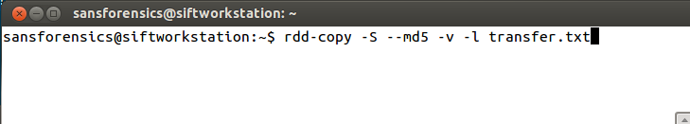
Once rdd is in Server mode, it waits for the connection.
Source: SANS Institute. Reproduced and used in accordance with the fair dealing provisions in section 29 of the Canadian Copyright Act for the purposes of education, research or private study. Further distribution may infringe copyright

Slide 35
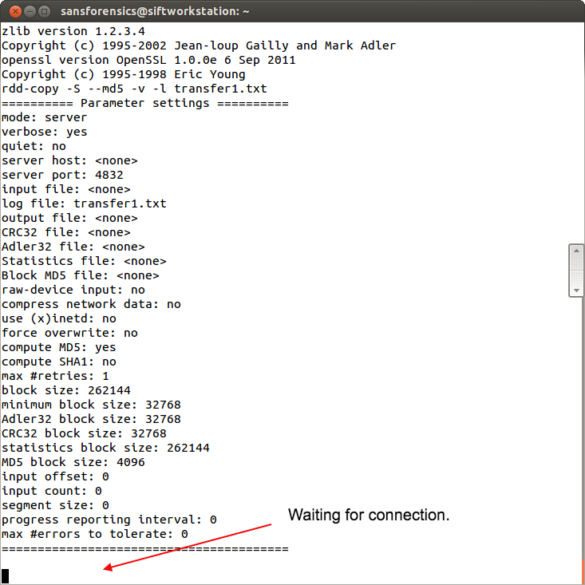
Waiting for the Connection
Source: SANS Institute. Reproduced and used in accordance with the fair dealing provisions in section 29 of the Canadian Copyright Act for the purposes of education, research or private study. Further distribution may infringe copyright

Slide 36
Step 2 — Remote Imaging with rdd
On the second system, run the command: rdd-copy —C --md5 (File to transfer) (IP of Server)(received filename) ]
rdd-copy -C --md5 Desktop/encoder.jar 192.168.215.210:encoder.jar
rdd-copy hashes the file and sends it to the rdd sever at the provided IP.

Slide 37
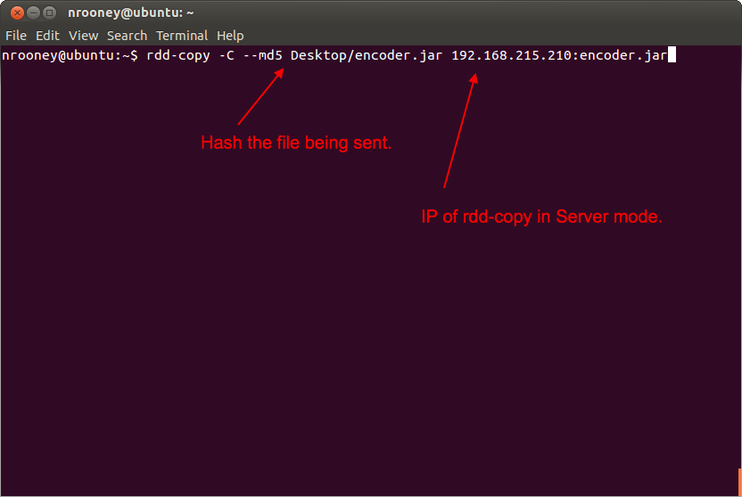
Source: SANS Institute. Reproduced and used in accordance with the fair dealing provisions in section 29 of the Canadian Copyright Act for the purposes of education, research or private study. Further distribution may infringe copyright

Slide 38
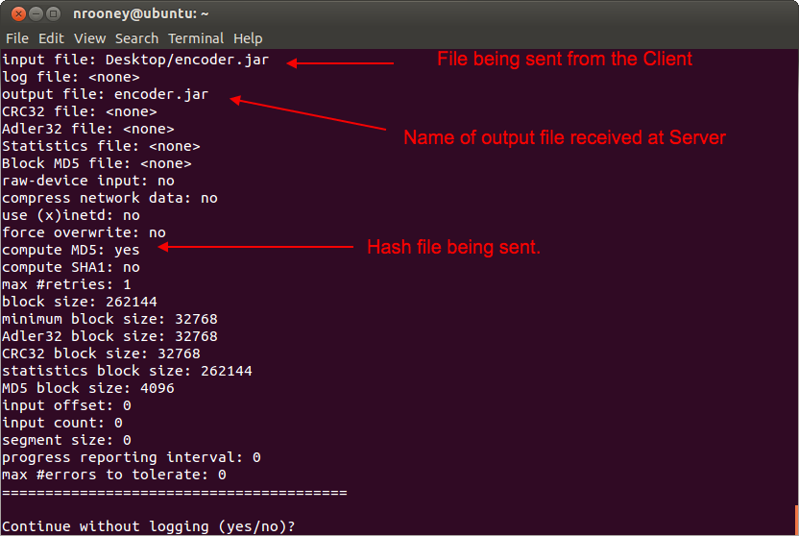
Press ENTER.
rdd-copy provides a summary of the request and asks for confirmation.
Source: SANS Institute. Reproduced and used in accordance with the fair dealing provisions in section 29 of the Canadian Copyright Act for the purposes of education, research or private study. Further distribution may infringe copyright

Slide 39
Step 3 — Remote Imaging with rdd
The transfer occurs.
On the Client side, rdd-copy completes and provides the md5 hash value of the sent file.
On the Server side, the file is received. A summary of the transfer is provided, including the md5 hash value.

Slide 40
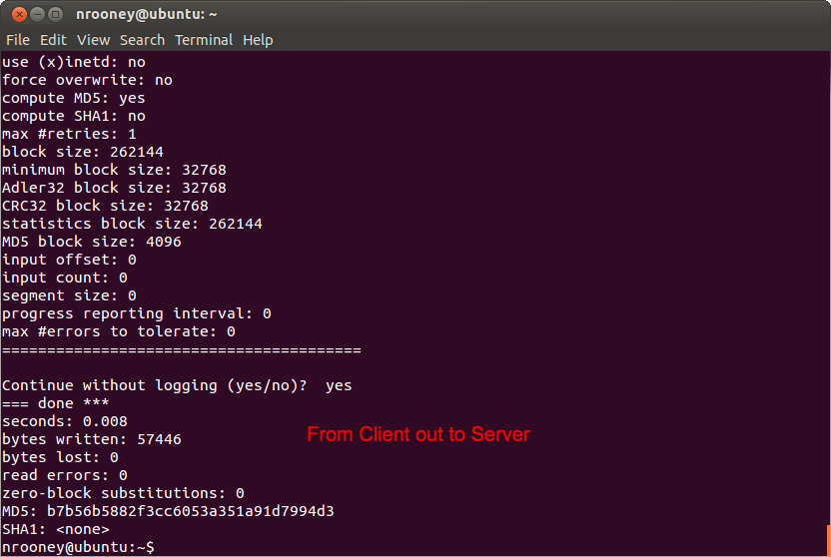
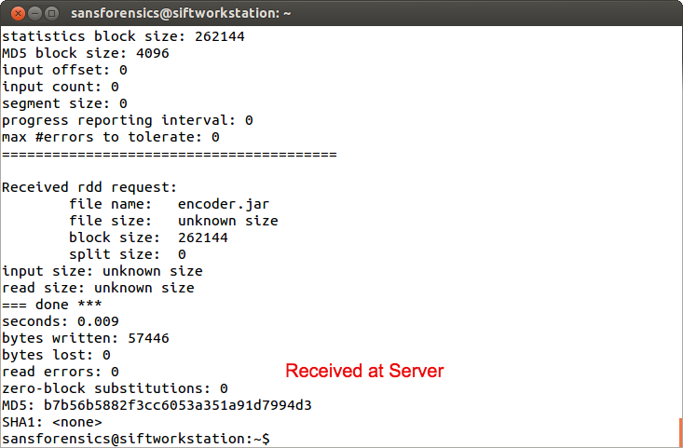
Client and Server Status
Source: SANS Institute. Reproduced and used in accordance with the fair dealing provisions in section 29 of the Canadian Copyright Act for the purposes of education, research or private study. Further distribution may infringe copyright
Notes:
Note that the md5 hash values match.

Slide 41
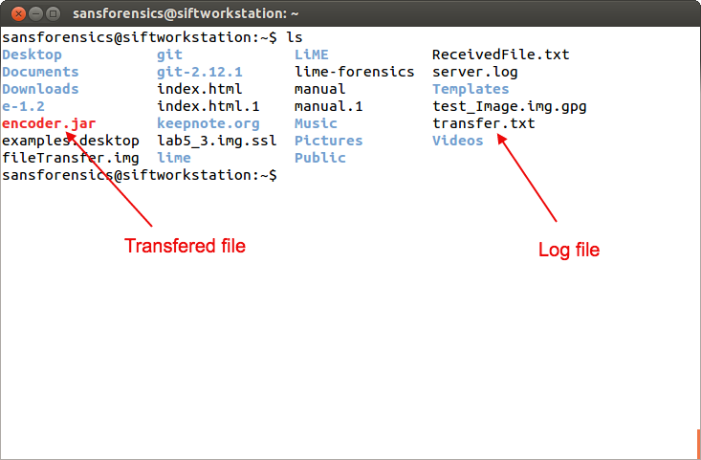
Step 4 — Server Side Confirmation
Source: SANS Institute. Reproduced and used in accordance with the fair dealing provisions in section 29 of the Canadian Copyright Act for the purposes of education, research or private study. Further distribution may infringe copyright

Slide 42
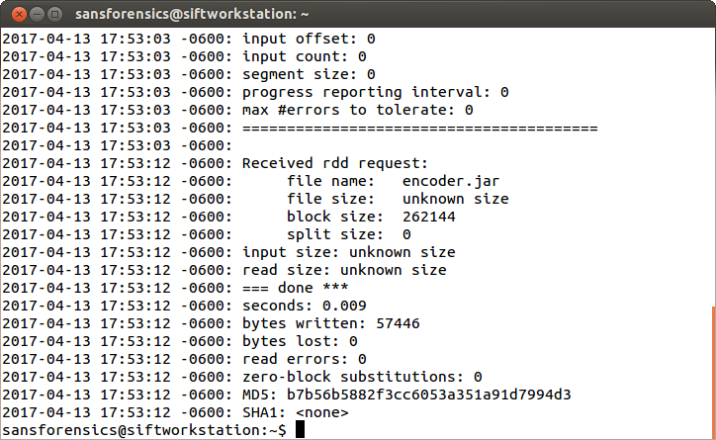
Step 4 — Server Side Confirmation
Cat the transfer.txt file to view the summary.
Source: SANS Institute. Reproduced and used in accordance with the fair dealing provisions in section 29 of the Canadian Copyright Act for the purposes of education, research or private study. Further distribution may infringe copyright

Slide 43
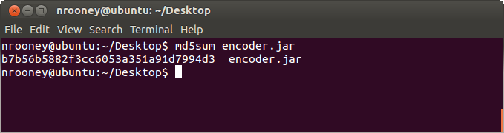
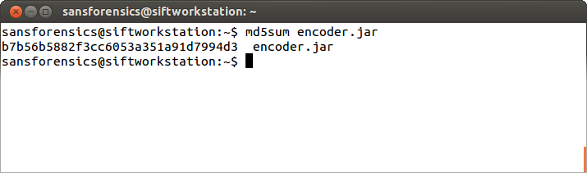
Step 4 — Server Side Confirmation
Note that the md5 hash values match for the file encoder.jar on both the client and server sides.
Source: SANS Institute. Reproduced and used in accordance with the fair dealing provisions in section 29 of the Canadian Copyright Act for the purposes of education, research or private study. Further distribution may infringe copyright

Slide 44
Commercial Tools
F-Response (www.f-response.com) is a multi-platform commercial tool that allows the investigator to conduct live forensics over the network
Integrates with forensic tools such as Volatility, X-Ways, Blacklight
EnCase Endpoint Investigator (www.guidancesoftware.com) is another commercial tool that allows the investigator to conduct live forensics over the network

Slide 45
Summary
Capturing data over the network involves capturing data on a live running system.
Because the system is powered on, data can be changing during the capture.
Network captures still involve someone interacting with the suspect system.
Use a secure shell when utilizing rdd.
Commercial tools such as F-Response and EnCase Endpoint assist the investigator in live forensics.

Slide 46
References
Ncat Users’ Guide. (n.d.) Retrieved Oct. 3, 2017 from https://nmap.org/ncat/guide/
SANS Institute (2017). SIFT Workstation [VMware Appliance]. Retrieved from https://digital-forensics.sans.org/community/downloads

Slide 47
© 2017, Southern Alberta Institute of Technology. All rights reserved.
This publication and materials herein are protected by applicable intellectual property laws. Unauthorized reproduction and distribution of this publication in whole or part is prohibited.
For more information, contact:
Director, Centre for Instructional Technology and Development
Southern Alberta Institute of Technology
1301 16 Ave. N.W., Calgary, AB T2M 0L4

